Slide 1
AVR Butterfly Appliance Control Module
Team C: Amruta Bapat
Christopher Majda Gaurav Dugge
Patrick Wiesen
Piyusha Vasekar
Project Guide : Prof. Dr-Ing. Thomas Siepmann
Dr-Ing. Shankar Subramanian
Date: 25-06-2014

Slide 2
Team Members and Roles
Project Manager (Patrick Wiesen)
Integration Manager
( Gaurav Dugge)
Technical Manager
(Christopher Majda)
Documentation Managers
(Amruta Bapat
Piyusha Vasekar)

Slide 3
Goals
To develop a AVR Butterfly Appliance Control Module according to the requirements documented.
To work in a team of 5 to accomplish the task by implementing the concepts for Requirements Engineering, SCM, PDM learnt in the course .
To divide the different responsibilities among team members and work in cooperation.
To document the project in Requirements Document, User Manual, Documented Source Code.

Slide 4
Requirements
Reset the system.
Set real time on the system.
Select device to be controlled (Device 1 / 2).
Select operation (device to be switched ON / OFF)
Select mode and set time (set real time at which or countdown time after which the device is to be switched on or off.)
Needs external Power supply to turn on / off the relays.
Devices operating on 230V, 10A could be supported. (Eg. Microwave, Office lighting systems etc to save electrical power)

Slide 5
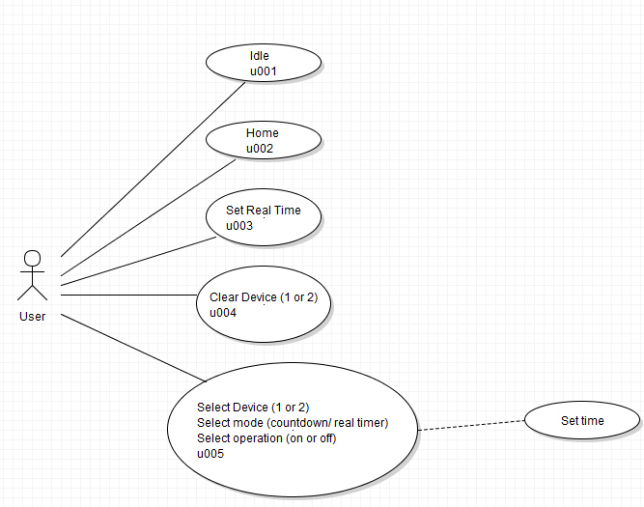
Use Case Diagram

Slide 6
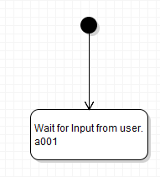
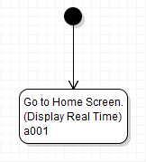
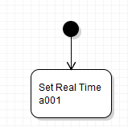
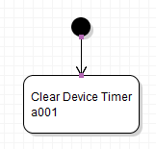
Activity Diagrams
Activity Diagram
u001
Activity Diagram
u002
Activity Diagram
u003
Activity Diagram
u004

Slide 7
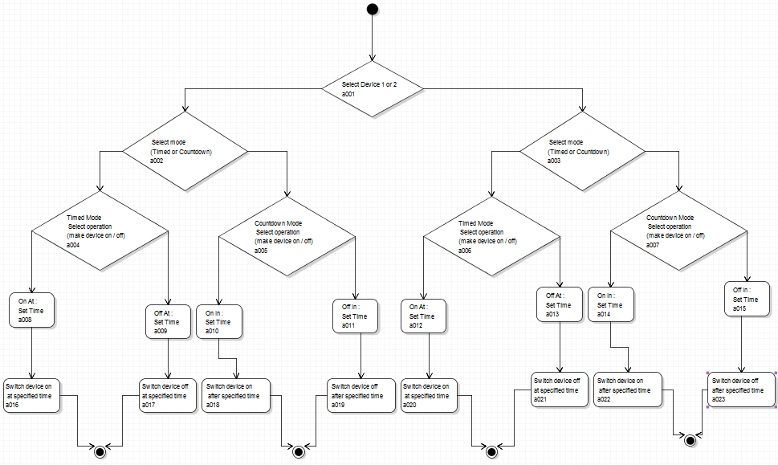
Activity Diagrams
Activity Diagram u005

Slide 8
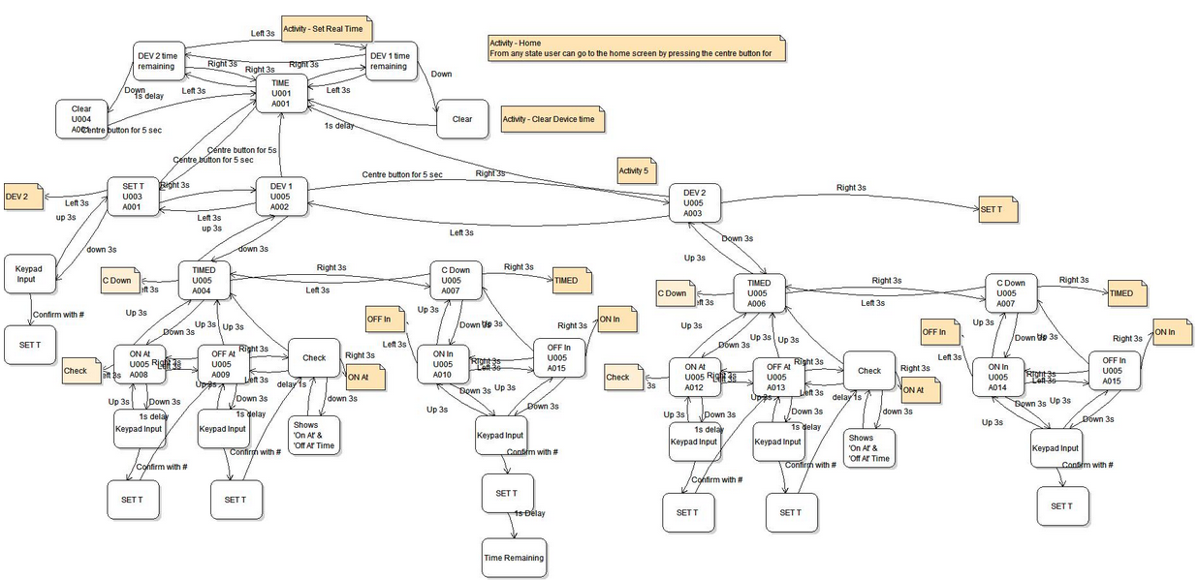
State Diagram

Slide 9
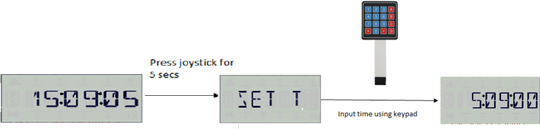
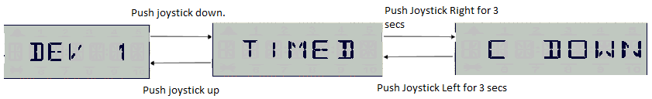

User Interface

Slide 10
Structure of Files
Project
Main.c
LookUpTable.h
LCD.h
Keypad.h

Slide 11
Tortoise interface

Slide 12
Programming

Slide 13
What were hard challanges?

Slide 14
Future Modifications
Multiple on / off time
Capability to control more than 2 devices
Bigger screen to achieve easier user interface
Save user settings even on power off
Acoustic feedback

Slide 15
What have we learned?
AVR Butterfly Board Application
Team work
Different roles and division of work among team members
Synchronization among team members
Way to handle big projects
Importance of documentation

Slide 16
THANK YOU FOR
YOUR ATTENTION!

